Slide 1

Mass Spectrometry-based Proteomics
Phil Gafken
Director, Fred Hutch Proteomics Resource
05/09/22 to 05/13/22

Slide 2
Course Outline
Monday Teams
Tuesday Teams
Wednesday Teams
What is Proteomics?
Mass Spectrometers
  Ionization
  Analyzers
  Dissociation
The Mass Spectrum
LC-MS & FAIMS
-LC-MS/MS
-Orbitrap Eclipse
Protein Identification
Protein Database Searching
Peptide Validation
Linking Peptide IDs to Proteins
Sample Preparation
Protein Quantification
Thursday Teams
Friday Teams
-Modification Analysis
-Serum Proteomics
-Facility Tour
-Emerging Topics in Proteomics (kinda)
  -Targeted Proteomics
  - MHC Peptides
  - Laser Capture Microdissection
-Proteome Discoverer 2.5 Demo
-Course Survey

Slide 3
Sample Preparation
Proteins and peptides must be in a form that
is compatible with LC-MS.
Good separation and purification techniques are
critical for good LC-MS.
Good LC-MS = Good results!
Only covering sample preparation for bottom-up methods

Slide 4
General Sample Preparation Scheme
(Bottom-up Proteomics)
Cell culture
Tissues
Serum/plasma
Protein Isolation
Protein Fractionation
1D/2D gels
Chromatographic
(optional)
Trypsin
Lys-C
Tryp/LysC
Glu-C
Chymotrypsin
One or the other is performed
Digestion
Peptide Fractionation
SCX
Basic-RP
(optional)
Desalting

Slide 5
Protein Isolation: Lysis/Solubilization
(Bottom-up Proteomics)
Denaturing Buffers
Typical Use
SDS
Urea
RapiGest
Thorough protein denaturation
Global proteome and PTM analysis
Non-Denaturing Buffers
Typical Use
Triton
NP40
RIPA
Maintains protein complexes
Affinity proteomics
Physical Disruption
Sonication
Cryo-pulverization
Beads
Pressure
Protease inhibitors typically added (phosphatase inhibitors usually added for phosphoPTM experiments)
Maintaining high sample concentration is important (> 1 µg/µL for global expts)

Slide 6
Protein Fractionation by 1D SDS-PAGE
SDS-PAGE = Sodium Dodecyl Sulfate Polyacrylamide Gel Electrophoresis
Protein Mixture
Denature with SDS
(negatively charged detergent)
-
-
-
-
-
-
-
-
-
-
-
-
-
-
-
-
-
-
-
-
-
-
-
-
-
-
-
-
-
-
-
-
-
-
-
-
-
-
-
-
-
-
-
-
PAGE
-
-
-
-
PAGE
Stain gel to visualize
protein bands
t₀
t₁
t₂
t₃
+
+
+
+

Slide 7
Protein Fractionation by 2D SDS-PAGE
Protein Mixture
pH gradient
(i.e. pH 4 to pH 9)
Isoelectric focusing
+
-
Add SDS
Join to polyacrylamide gel
-
Orthogonal separation allows for better resolution as compared to 1D gels
+

Slide 8
Protein Fractionation by Gel
You might want to know…
In Gel:
  Acrylamide % isn’t a problem; TAU gels work also
  Virtually any type of gel system works
  Coomassie- or silver-stained bands are okay
  Unstained gels are possible (rainbow markers to define regions)
  Multiple proteins in a band aren’t a problem
  Gels are fantastic for removing protein lysis/solubilization reagents
  Gels can separate contaminating proteins (H/L chain)
  Denaturing condition of gel aids digestion
  Maintain information about protein’s MW will gel MW markers

Slide 9
Protein Fractionation in Solution
Liquid
Phase
Stationary
Phase
t₀
t₁
t₂
t₃
t₄
t₅
I
time

Slide 10
Types of Liquid Chromatography
Type
Mode of Separation
Cation or anion exchange
+ or - Charge
Reverse phase
Hydrophobicity
Size exclusion
Size
Affinity
Specific functional groups

Slide 11
Protein Fractionation in Solution
You might want to know…
In Solution:
  More sensitive than gels? (peptide recovery less of an issue?)
  Contaminants are more of a problem, especially detergents
  pH must match digestion conditions
  Volume must be controlled (< 500 uL); protein ppt (TCA, acetone
  might be useful)
  Multiple proteins present aren’t a problem
  Protein fractionation is frequently skipped, and complex mixtures can be simplified by peptide fractionation methods

Slide 12
Protease Digestion
Gel slice digestion
1.
1. Wash
Cut band from gel
2. Reduction & alkylation
desalt
(1D or 2D)
3. In-gel digestion
4. Elute peptides
5. Reduce elution volume
2.
1. Wash
Cut band from gel
2. Reduction & alkylation
desalt
(1D gel)
3. In-gel digestion
4. Elute peptides
5. Reduce elution volume
Solution digestion
1. Adjust pH
desalt
2. Reduce and Alkylate
HPLC fraction
or
IP elution
3. Digestion

Slide 13
Protease Digestion
1. Reduction: Dithiothreitol (DTT), TCEP, β-mercaptoethanol
R₁
SH
S
R₁
+
Don’t exceed 56℃ in presence of urea (carbamylation)
R₂
S
56℃
SH
R₂
2. Alkylation: Iodoacetamide, chloroacetamide, MMTS
= O
= O
CH₂-S-H
+
I-CH₂-C-NH₂
CH₂-S
-CH₂-C-NH₂
+
HI
RT, dark
Don’t use IAA for ubiquitin proteomics (IAA lysine adducts mimic diGly Ub tag)
Both steps usually performed under denaturing conditions

Slide 14
Protease Digestion
You might want to know…
Proteases:
  Trypsin is most common protease used
    Cleaves after K &R (reduced activity for KP and RP)
    Cheap and readily available
    Generally produces peptides 700-3000 Da; ideal for MS
    Very active in both gel and solution (urea < 2 M)
    Autodigestion needs to be controlled; keep cool until ready to activate with protein
  pH, amounts of salts and detergents must be controlled
  Other proteases work well in solution but are difficult to use in -gel(?!)
    Lys-C active at high urea concentrations
    Lys-C at high [urea], followed by trypsin at lower [urea]
    Other proteases used for peptide mapping
  Knowing starting amount of protein very helpful for optimizing digestion

Slide 15
Peptide Fractionation
Goal:
Divide the complex mixture into less complex fractions that are more amenable to LC-MS
Most common methods:
Strong cation exchange chromatography
Basic reverse phase chromatography
Isoelectric focusing
These methods provide a first dimension of separation
LC-MS provides a second degree of fractionation

Slide 16
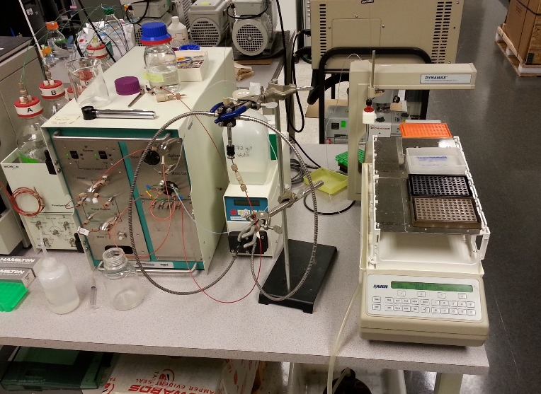
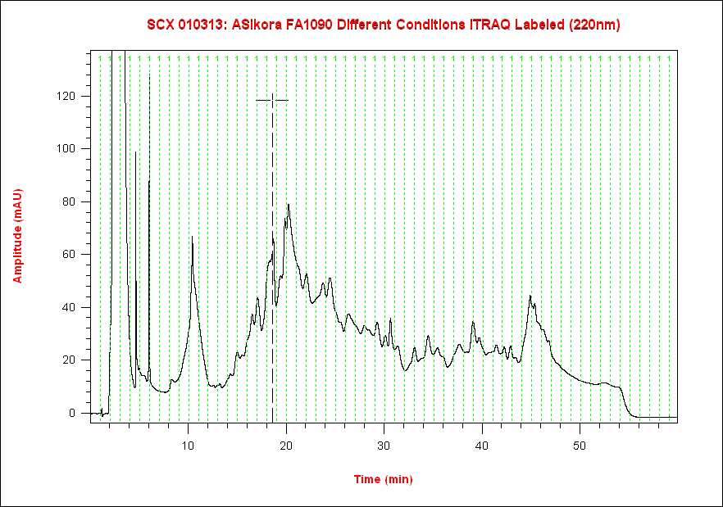
Peptide Fractionation
(complex mixtures)
Strong-Cation Exchange Chromatography
Amplitude (mAU)
- Separation is based on solution charge of peptide (+1, +2, +3, +4)
- Limited fractionation ability
- Fractions are pooled, desalted and run by MS
Time (min)
Proteins
Peptides
SCX

Slide 17
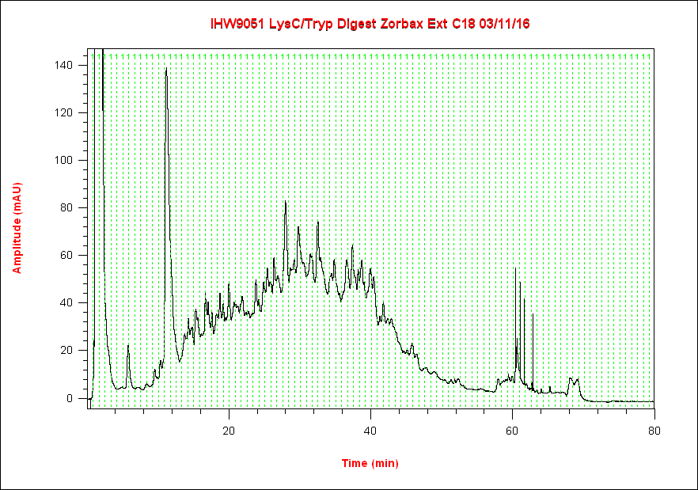
Peptide Fractionation
(complex mixtures)
Basic Reverse Phase Chromatography
- Standard reverse phase separation, but performed at pH 8
- Separation based on hydrophobic properties of peptides
- Generally, a more even distribution of peptides over chromatogram
- Fractions are pooled and taken to dryness (usually 24 pools)
- Volatile elution buffer that can be removed by vacuum centrifugation
Proteins
Peptides
bRP
Pooling scheme: Pool 1 = F1, F25, F49, F73; Pool 2 = F2, F26, F50, F74; etc.

Slide 18
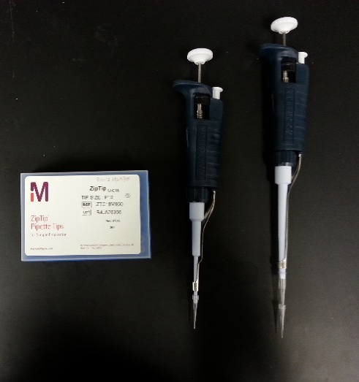
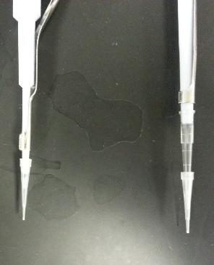
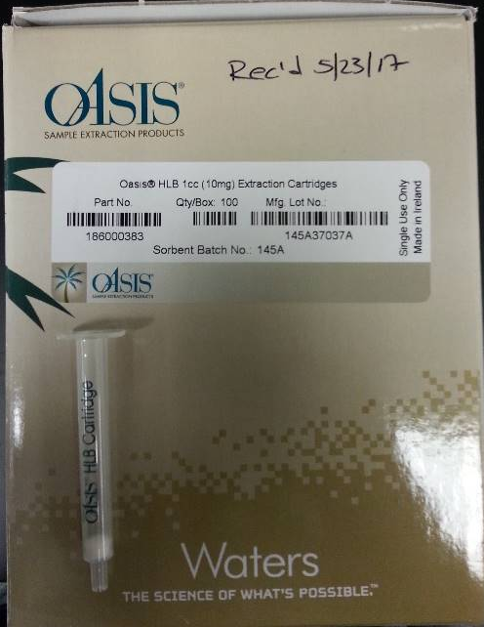
Peptide Desalting
ZipTips (Millipore)
C18 (5-10 µg)
µC18 (2-5 µg)
SCX
P200 tip
OASIS Cartridges (Waters)
Multiple sorbent types
Up to 100 µg
Numerous companies sell desalting devices

Slide 19
The Need for Good Sample Prep
(an example)
Identification of proteins that interact with
metabotropic glutamate receptors 1 & 5
Carol Farr and Julie Saugstad
R.S. Dow Neurobiology Lab
Portland, OR

Slide 20
The Need for Good Sample Prep
(Solution vs. Gel )
1. Protein complex in solution
2. Antibody capture of complex
Immunoprecipitation
experiment
3. Elute purified complex
Proteolytic digestion
LC-ESI MS/MS
“Shotgun approach”

Slide 21
The Need for Good Sample Prep
(Solution vs. Gel )
Total Ion Chromatogram
Solution digest
of protein
complex
m/z
m/z
m/z
m/z

Slide 22
The Need for Good Sample Prep
(Solution vs. Gel )
1. Protein complex in solution
-
Cut Regions
2. Antibody capture of complex
+
SDS-PAGE
In-gel
Proteolytic
digestion
3. Elute purified complex
LC-ESI MS/MS

Slide 23
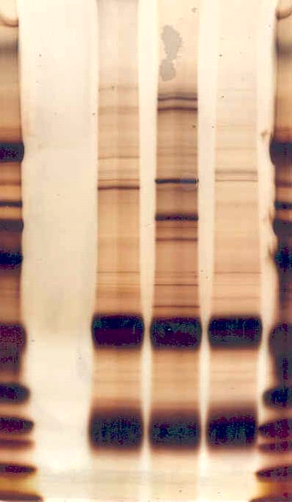
The Need for Good Sample Prep
(Solution vs. Gel )
Lane 1 = mGluR1
Lane 2 = mGluR5
Lane 3 = CB
1
2
3
Lane
1
2
3
Slices
STDs
J
Gel purification
of IP samples
kDa
I
198
H
114
G
96
Sample processing
performed on
unstained gels
F
53
E
D
36
antibody
C
28.5
B
18.5
A
J. Neurochem. 91:438 (2004)

Slide 24
The Need for Good Sample Prep
(Solution vs. Gel )
Total Ion Chromatogram
Gel slice digestion

Slide 25
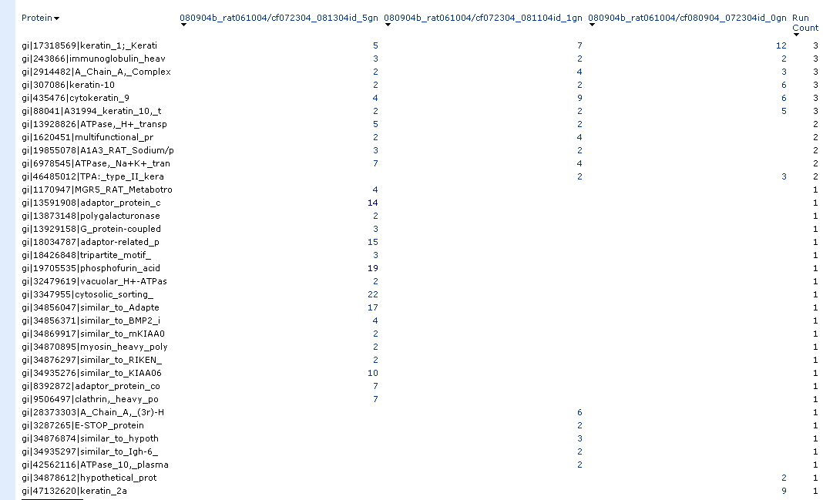
The Need for Good Sample Prep
(Solution vs. Gel )

Slide 26
What is Not Compatible with LC-MS
Reagent | Why it is not compatible | How to deal with it
Detergents | - Dominates mass spectra; mass spec. spends it time only on detergent signals - Suppresses signal of peptides - Trashes instrument | - Protein Precipitation - Run into gel - Avoid using them - MS-friendly detergent - Removal tips (New!)
Salts | - Non-volatile; dirties instrument; more frequent cleaning of instrument | - Desalting!
Perfluoronated acids (e.g. TFA, HFBA, HFIP) | - Dramatically reduces sensitivity of instrument; has long “memory effect”! | - Speed vac to remove (volatile) - Use formic or acetic acid
Non-volatile organic solvents (e.g. DMSO, DMF) | - Negatively alters HPLC | - Dilute if possible - Avoid using them

Slide 27
Protein Quantification
Label-free and isotopic labeling approaches

Slide 28
Representation of Shotgun Data
(MS with MS/MS data)
MS/MS
4
MS/MS
1
3
MS/MS
Intensity
MS/MS
2
MS
MS
MS
MS
Time (scan#)

Slide 29
Spectral Counting
 | ORBITRAP_50fmol_UPS49_03.pep.xml (040207/LN040507_50fmol_UPS49_03 (UniprotHum_RA_20070222)) | ORBITRAP_5fmol_UPS49_02.pep.xml (040207/LN040207_5fmol_UPS49_02 (UniprotHum_RA_20070222))
Protein | Total | Total
IPI00022389 | 6 | 1
IPI00022434 | 30 | 5
IPI00022463 | 36 | 9
IPI00026314 | 8 | 4
IPI00027487 | 14 | 5
IPI00028064 | 7 | 1
IPI00032291 | 6 | 2
IPI00218414 | 13 | 6
IPI00219684 | 10 | 2
IPI00219757 | 12 | 2
IPI00288914 | 3 | 1
IPI00413587 | 12 | 2
IPI00465315 | 6 | 3
IPI00479848 | 9 | 2
P02788|TRFL_HUMAN | 35 | 11
P04040|CATA_HUMAN | 24 | 14
P35527|K1C9_HUMAN | 16 | 10
PIR1:AQHUP | 11 | 5
PIR1:CSHUA | 7 | 1
PIR1:HAHU | 6 | 1
PIR1:HBHU | 9 | 7
PIR1:KRHUEA | 13 | 7
UPSP:ANT3_HUMAN | 14 | 7
gi|51703341 | 2
GP:AL031058_1 | 2
IPI00000073 | 1
IPI00001671 | 1
IPI00009867 | 7
IPI00012009 | 1
IPI00017730 | 1
IPI00019524 | 1
IPI00022429 | 1
IPI00025753 | 1
IPI00027547 | 1
IPI00032957 | 2
IPI00216298 | 3
IPI00218733 | 2
IPI00219018 | 1
IPI00293665 | 1
IPI00303105 | 5
Total spectra matched to each protein in each run is compared
# of MS/MS identifications can be related to abundance
No labeling is required

Slide 30
Qualities of Spectral Counting
Summary details:
Analytical conditions for each sample must be identical
Only useful for comparing a protein across samples
Relative quantitative method
Pros:
Low cost (does not require costly reagents)
Minimal changes to standard sample prep
Spectral counts come for “free” with protein identification results
Cons:
Low quantitative precision
Low/no peptide counts can be unreliable (small proteins, low abundance, low observations)
High sample handling variability
No multiplexing; replicates help with confidence (increased analytical burden)
Typical Use:
For general quantitative view
Immunoprecipitations
After thought (after seeing results)

Slide 31
Label Free Quantification
Run#1
Run#1
*
Run#2
Run#2
*
Total Ion Chromatogram
(measure total signal from all ions over time)
Survey Scan
Reconstructed Ion Chromatogram
(measure single ion over time)

Slide 32
Qualities of Label-Free Quant.
Summary details:
Analytical conditions for each sample must be identical
Sum peptides for a protein; shared peptides are usually omitted from quantification
Relative quantitative method; intensity or peak area can be used
Pros:
Low cost (does not require costly reagents)
Minimal changes to standard sample prep
Software for quantification is available (MaxQuant, Proteome Discoverer)
Cons:
Intermediate quantitative precision
High sample handling variability
No multiplexing; replicates help with confidence (increased analytical burden)
Typical Use:
Low complexity samples; low sample amounts
Immunoprecipitations
After thought (after seeing results)

Slide 33
SILAC
(Stable Isotope Labeling with Amino acids in Culture)
¹³C
A
B
Cells grown in culture and fed
essential, isotopically labeled
amino acid (i.e. ¹³C₆-arginine)
^{light}
^{heavy}
NH
O
NH
O
=
=
=
=
H₂N
N
OH
H₂N
N
OH
H
NH₂
Pool Samples
Harvest Proteins
H
NH₂
Arg₊₀(Light)
Arg₊₆(Heavy)
Trypsin Digestion
Resulting in Peptide Mixture
A
6 Da
MS1
Intensity
B
Mass Spectrometry
Labeling kits sold
by many vendors
m/z

Slide 34
Qualities of SILAC
Summary details:
Isotopically labeled, essential amino acids used (¹³C_{6,} ¹⁵N₄-Arginine (+10) and ¹³C_{6,} ¹⁵N₂-Lysine (+8) )
Potential to label all proteins
Multiple peptides per protein for quantification
Quantification measurements are relative
Shared peptides usually omitted from quantification
Pros:
Very high quantitation precision
Combining samples prior to protein extraction minimizes downstream handling errors
Applicable to protein modifications
Cons:
Cannot be used for primary tissue and fluids (caveat: isotopically labeled mouse)*
Expensive
System must be SILAC compatible
Increases the complexity of the mass spectrum due to isotopic pairs
Low degree of multiplexing
S. Ong, et al: Mol Cell Proteomics 1 (2002) 376-386
S. Ong, I. Kratchmarova, and M. Mann: J. Proteome Res 2 (2003) 173-181
* C.C Wu, et al: Anal Chem 76 (2004) 4951-4959
S. Ong, L.J. Foster, and M. Mann: Methods 29 (2003) 124-130

Slide 35
SILAC: Label Swapping
Experiment 1
Up-regulated
proteins
Contaminant
proteins
Light
Heavy
1 2 3
Cell Line A
Cell Line B
Mix 1:1
Exp 2: Log2 (Cell line B/Cell line A) L/H
-3 -2 -1
1 2 3
Experiment 2
Unchanged
proteins
Light
Heavy
-3 -2 -1
Cell Line B
Cell Line A
Down-regulated
proteins
Mix 1:1
Exp 1: Log2 (Cell line B/Cell line A), H/L

Slide 36
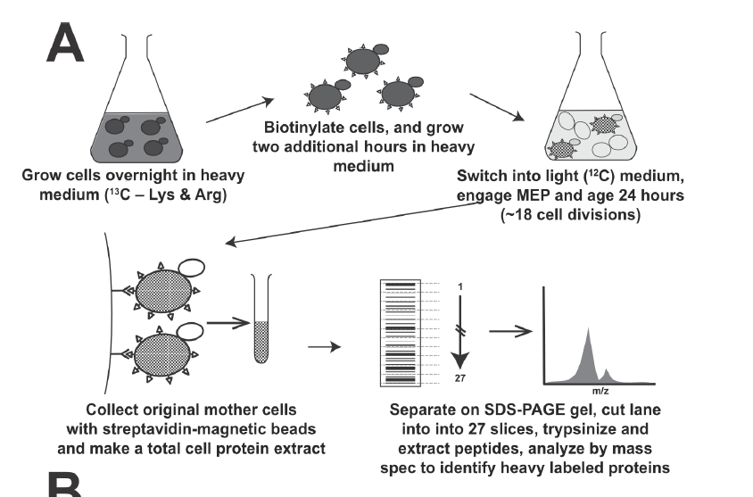
Example of SILAC Experiment
(Identification of long-lived proteins)
Pulse-chase experiment
- H/L > 0.1 indicates long-lived protein
L
H
Slide courtesy of Nate Thayer and Dan Gottschling
PNAS 111:140 (2014)

Slide 37
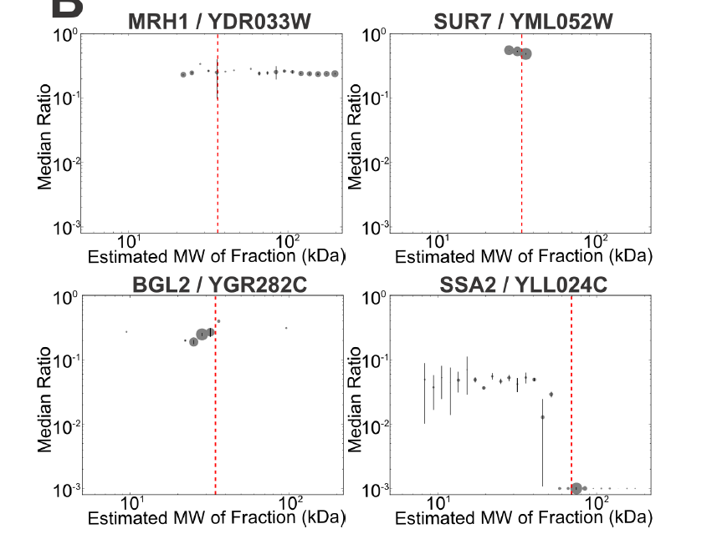
Example of SILAC Experiment
(Identification of long-lived proteins)
- Full-length and fragmented proteins identified
- Cell wall proteins (BGL2) are known to remain with the mother throughout her lifespan
Dot size represents relative amount of peptides in that slice
Red line is expected MW of protein
Slide courtesy of Nate Thayer and Dan Gottschling
PNAS 111:140 (2014)

Slide 38
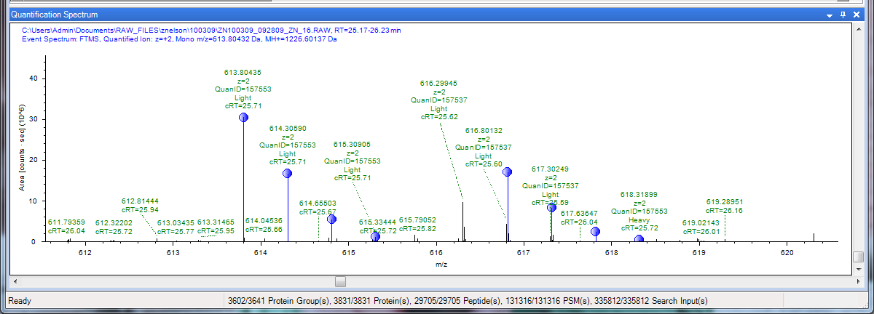
Example of SILAC Experiment
(Identification of long-lived proteins)
LASTYSIDNSR
YML052W_SUR7 (Plasma membrane protein)
H/L = 0.525

Slide 39
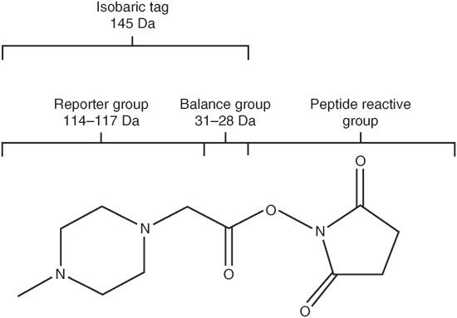
iTRAQ
Isobaric Tags for Relative and Absolute Quantification
¹³C
¹⁵N
¹⁸O
Peptide Reactive Group
Reporter Group
Balance Group
H⁺
114
114 +
31
H⁺
115
115 +
30
Fragmentation
Fragmentation Site
H⁺
116
P.L. Ross, et al: Mol. Cell. Prot. 3.12 (2004) 1154-1169
116 +
29
H⁺
117
117 +
28
All reagents have the same mass

Slide 40
iTRAQ
4-plex experimental setup
Multiplex Processing
Condition 1
114
Sample 1
Sample 2
Sample 3
Sample 4
Reduce, Alkylate,
and Digest
Reduce, Alkylate,
and Digest
Reduce, Alkylate,
and Digest
Reduce, Alkylate,
and Digest
Condition 2
115
Digest 1
Digest 2
Digest 3
Digest 4
Tag 114
Tag 115
Tag 116
Tag 117
Condition 3
116
Tag 1 Peptides
Tag 2 Peptides
Tag 3 Peptides
Tag 4 Peptides
Condition 4
117
Combine Peptide Mixtures
Fractionate, MS Analysis

Slide 41
iTRAQ
The Mass Spectra
Since the iTRAQ labeling reagents are isobaric, identical peptides from different
samples have the same mass (in MS1).
Fragment ions for identifying the peptide are also present
Reporter fragment ions are present in MS2 that allow quantification of the peptide in
each sample
M1 spectra
Intensity
Selection of precursor ion for MS2
0
m/z
2000
M2 spectra
115
116
B- and y-ions are present
allowing for identification
of peptide
Intensity
117
114
Intensity
110
m/z
120
Abundance ratios are:
1:4:4:2
0
2000
m/z

Slide 42
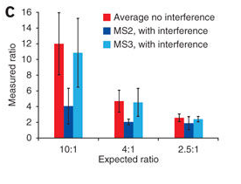
iTRAQ
Co-isolation problem
Ion selected for MS2 may not be pure
Ions with very close m/z will also be selected
“Contaminating” ions the MS2 spectra will reduce the accuracy of the quantification, typically compressing the quantitation ratios
Synchronous precursor scanning (MS3) can eliminate ratio distortion, but at reduced data collection rates (increased quant. accuracy, but reduced protein ids)
M1 spectrum
Selection of precursor ion for MS2
Intensity
0
m/z
2000
MS2 Spectrum
Quantification
Nature Methods 8, 937 (2011)

Slide 43
Qualities of iTRAQ
Summary details:
Potential to label all proteins
Multiple peptides per protein for quantification
Quantification is relative
Could be used for time course experiments
Pros:
Multiplexing up to 8 samples (very cool), 18-plex for TMT (Thermo) is available
Reasonably high quantitation precision
Can be used for clinical samples (biopsies, fluids)
Applicable to protein modifications
Cons:
Extensive sample labeling biochemistry (not so much a “con” as a warning)
Samples combined after protease digestion
Expensive
Co-isolation of precursor ions can reduce quantitative accuracy
P.L. Ross, et al: Mol. Cell. Prot. 3.12 (2004) 1154-1169

Slide 44
Example of iTRAQ Experiment
(N. gonorrhoeae therapeutic targets)
- Neisseria gonorrhoeae is second most commonly reported infection in the US
- Estimated 62 million cases occur each year (worldwide)
- Infections cause all sorts of problems (genital infections, blood infections, PID, ectopic pregnancy, infertility)
- Resistance to antibiotic treatment is growing; WHO estimates N. gonorrhoeae could be resistant to current drugs by 2015
- Cell envelop and membrane vesicles play a role in colonization and infection of human tissues and cell lines
- Thorough proteomic analysis of the cell envelop and membrane vesicles was performed to identify potential therapeutic targets
Aleksandra Sikora and Ryszard Zielke, Oregon State University

Slide 45
Example of iTRAQ Experiment
(N. gonorrhoeae therapeutic targets)
765
568
308
213
Mol Cell Proteomics 13: 1299 (2014)
Final
316 CE & 57 MV

Slide 46
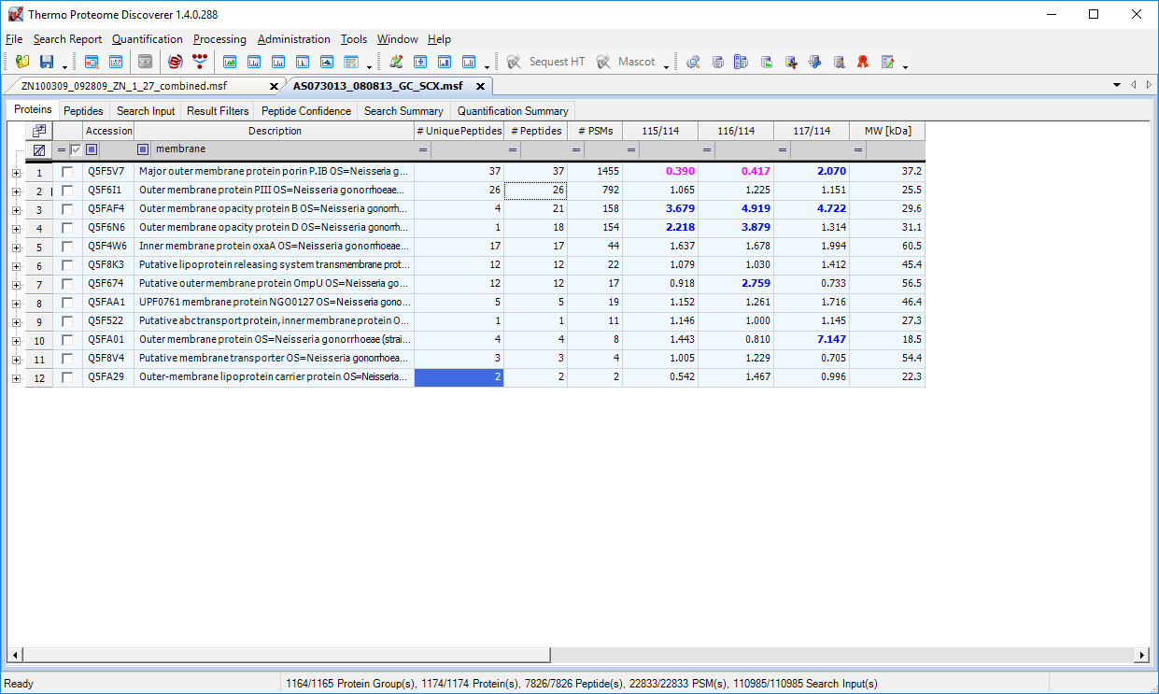
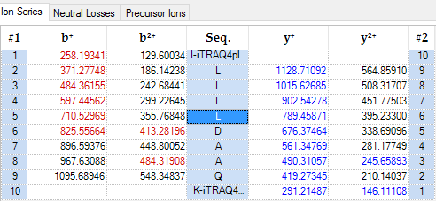
Example of iTRAQ Experiment
(N. gonorrhoeae therapeutic targets)
115/114
116/114
117/114
1.15
1.32
1.81
L

Slide 47
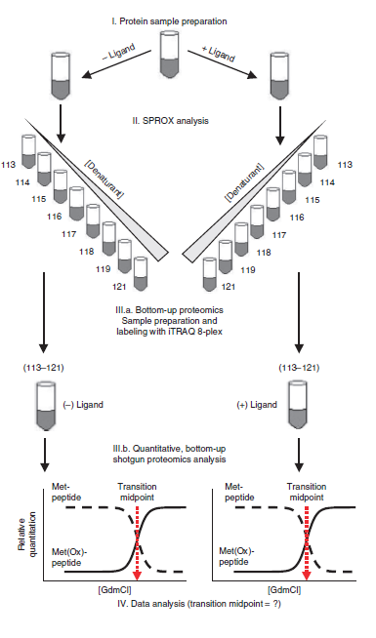
Example of iTRAQ Experiment
(SPROX-Stability of Proteins from Rates of Oxidation)
- Measures folding free energies and K_{d} values of protein ligand complexes on a proteomics scale
- H₂O₂ used to induce oxidation on Met as a function of denaturant concentration
- Used to identify proteins that bind tested ligands
- Identification of drug targets
- Change in the transition midpoint for Met-peptides in (-) Ligand and (+) Ligand samples allows for free energy calculations
Nat Protoc. 8:146 (2013)

Slide 48
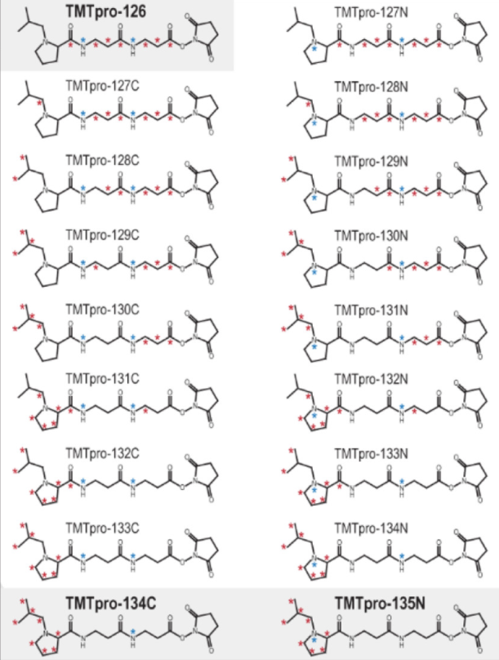
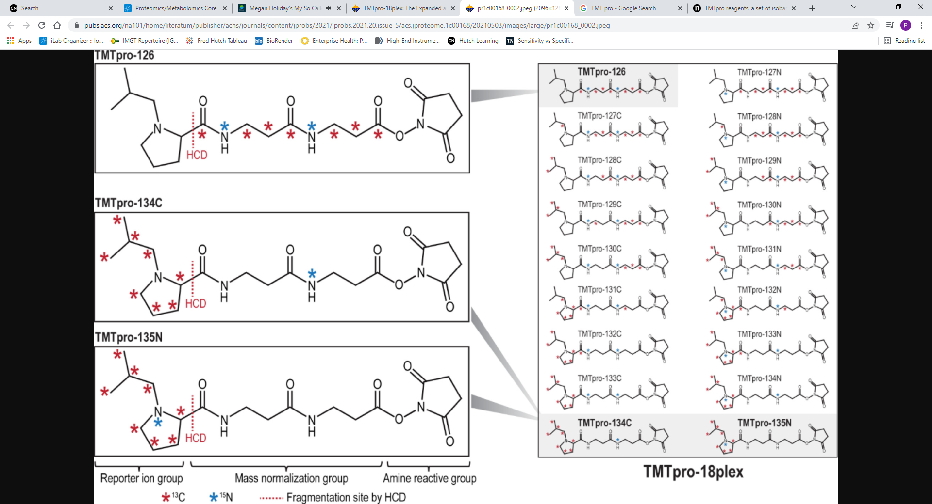
TMT-Pro 18plex
(Design)
TMTpro-126
TMTpro-127N
*
TMTpro-127C
*
Reconfigured figure from Li et. al. J. Proteome Res 20, 2964-2972 (2021)

Slide 49
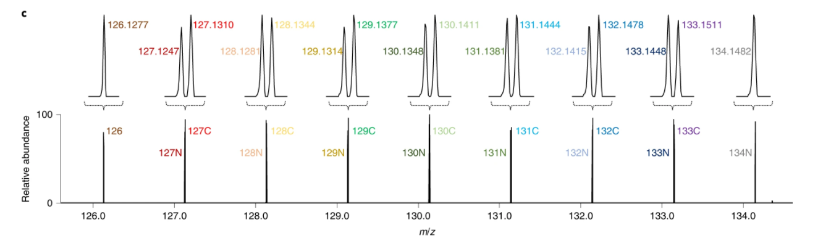
TMT-Pro 18plex
(Chemistry)
Mass of Reporter Ion
TMTpro-126
126.127726
126.127726
+ 0.997034
TMTpro-127N
127.124760
*
Δm = 0.006321
+ 1.003355
TMTpro-127C
*
127.131081
¹⁵N = 15.000108
-
¹⁴N = 14.003074
0.997034
¹³C = 13.003355
-
¹²C = 12.000000
1.003355
Reconfigured figure from Li et. al. Nature Methods 17, 399-404 (2020)

Slide 50
TMT-Pro 18plex
(The Mass Spectrum)
MS2
MS2

Slide 51
Absolute Quantification of Proteins by MS
AQUA
Protein
lysate
Select protein of
interest
Select tryptic
peptide for
quantification
…TLSDYNIQK…
1. Trypsin digestion
2. Introduce known amount
of reference (heavy) peptide
Synthesize reference
peptide with heavy
isotopes (¹³C, ¹⁵N)
H₂N-TLSDYNIQK-COOH
3. LC MS/MS
4. Extracted ion chromatogram
Characterize fragmentation
spectrum for identification
LC MS/MS
18.5
18.5
18.5
Light- analyte peptide
Use extracted ion chromatogram
to test quant. conditions
time
Heavy- reference peptide
time
5. Quantify ratio
6. Determine protein amount

Slide 52
Qualities of Absolute Quantification
Summary details:
Isotopically labeled amino acids are commercially available, synthesis of reference
peptide is almost trivial
Arginine ¹³C₆,¹⁵N₄ and lysine ¹³C₆,¹⁵N₂ increase peptide mass by 10 Daltons and 8 Dalton, respectively, as compared to light peptide
Choose a tryptic peptide which resolves well by HPLC. Avoid very hydrophobic
or very hydrophilic peptides.
Choose peptide that ionizes well
Light and heavy peptides co-elute
Pros:
Absolute quantification (not relative!) can be achieved; high precision & accuracy
Multiplexing can be performed (multiple synthetic peptides)
Method can be applied to clinical samples (serum, urine)
Method can be applied to quantifying protein modifications
(For phosporylation, see S.A. Gerber, et al: PNAS 100 (2003) 6940-6945)
Cons:
Setting up can be time consuming and challenging
Synthetic peptide standards are expensive

Slide 53
Quantification Summary
 | Spectral Counts | Label-free Quant. | iTRAQ/TMT | SILAC | AQUA
Cost | ø | ø | $ | $$ | $$$
Multiplexing | None | None | 8/18 samples | 2-3 samples | 50-100 proteins
Sample Prep. | Low | Low | High | Medium | Very High
Precision | Low | Low | Good | Very Good | Excellent
When is “better” the enemy of “good enough”?

